Slide 1
Data Model (UNIT II)
A collection of tools for describing
Data
Data relationships
Data semantics
Data constraints
Relational model
Entity-Relationship data model (mainly for database design)
Object-based data models (Object-oriented and Object-relational)
Semi-structured data model (XML)
Other older models:
Network model
Hierarchical model

Slide 2
Relational Databases
A relational database is based on the relational data model
Data and relationships among the data is represented by a collection of tables
Includes both a DML and a DDL
Most commercial relational database systems employ the SQL query Language.
Create two tables & relation between these two tables with Relational Data Model.
Example in which consider table Customer & his Bank detail such as balance , Account number & depositor.

Slide 3
Relational Model
Attributes
Example of tabular data in the relational model

Slide 4
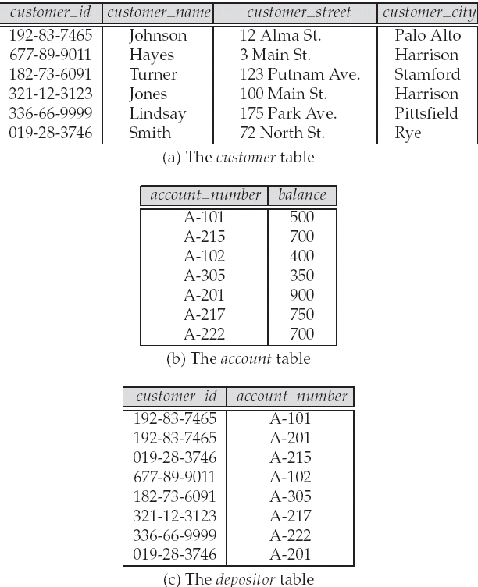
A Sample Relational Database

Slide 5
SQL
SQL: widely used non-procedural language
Example: Find the name of the customer with customer-id 192-83-7465 select customer.customer_name from customer where customer.customer_id = ‘192-83-7465’
Example: Find the balances of all accounts held by the customer with customer-id 192-83-7465 select account.balance from depositor, account where depositor.customer_id = ‘192-83-7465’ and depositor.account_number = account.account_number
Application programs generally access databases through one of
Language extensions to allow embedded SQL
Application program interface (e.g., ODBC/JDBC) which allow SQL queries to be sent to a database

Slide 6
Database Design
The process of designing the general structure of the database:
Logical Design – Deciding on the database schema. Database design requires that we find a “good” collection of relation schemas.
Business decision – What attributes should we record in the database?
Computer Science decision – What relation schemas should we have and how should the attributes be distributed among the various relation schemas?
Physical Design – Deciding on the physical layout of the database

Slide 7
The Entity-Relationship Model (E-R diagram)
Models an enterprise as a collection of entities and relationships
Entity: a “thing” or “object” in the enterprise that is distinguishable from other objects
Described by a set of attributes
Relationship: an association among several entities
Represented diagrammatically by an entity-relationship diagram:

Slide 8
Object-Relational Data Models
Extend the relational data model by including object orientation and constructs to deal with added data types.
Allow attributes of tuples to have complex types, including non-atomic values such as nested relations.
Preserve relational foundations, in particular the declarative access to data, while extending modeling power.
Provide upward compatibility with existing relational languages.

Slide 9
Transaction Management
A transaction is a collection of operations that performs a single logical function in a database application
Transaction-management component ensures that the database remains in a consistent (correct) state despite system failures (e.g., power failures and operating system crashes) and transaction failures.
Concurrency-control manager controls the interaction among the concurrent transactions, to ensure the consistency of the database.

Slide 10
Database Architecture
The architecture of a database systems is greatly influenced by
the underlying computer system on which the database is running:
Centralized
Client-server
Parallel (multi-processor)
Distributed

Slide 11
Database Users
Users are differentiated by the way they expect to interact with
the system
Application programmers – interact with system through DML calls
Sophisticated users – form requests in a database query language
Specialized users – write specialized database applications that do not fit into the traditional data processing framework
Naïve users – invoke one of the permanent application programs that have been written previously
Examples, people accessing database over the web, bank tellers, clerical staff

Slide 12
Database Administrator
Coordinates all the activities of the database system; the database administrator has a good understanding of the enterprise’s information resources and needs.
Database administrator's duties include:
Schema definition
Storage structure and access method definition
Schema and physical organization modification
Granting user authority to access the database
Specifying integrity constraints
Acting as liaison with users
Monitoring performance and responding to changes in requirements

Slide 13
Overall System Structure

